Slide 1
Minimum Edit Distance
Jonas Buro
July 2023
CSC 226 UVIC

Slide 2
Dynamic Programming Review
Algorithmic paradigm for solving problems which have dependent overlapping subproblems
Solution methods simplify the problem by breaking it down into smaller problems recursively
Optimal substructure, overlapping sub-problems conditions
e.g. Finding the nth Fibonacci number, weighted interval scheduling, knapsack problem
Notes:
19

Slide 3
Dynamic Programming Steps
Define a subproblem and recurrence relation relating a solution of a larger problem to solutions of smaller subproblems
(F_n = F_n-1 + F_n-2)
Find solution for the base subproblems
(F_0 = 0, F_1 = 1)
Record solutions in a table
Use solutions from smaller problems to build solutions to larger problem using recurrence relation
Notes:
19

Slide 4
Minimum Edit Distance problem
Find the number of edits (insertions, deletions, replacements) required to change one string into the other
Input: two strings, A of length m, B of length n
Output: number of required edits to change A to B
Notes:
19

Slide 5

Minimum Edit Distance example
What is the min. edit distance for food and money?
4
Notes:
19

Slide 6

Minimum Edit Distance
We can visualize this process by stacking the two strings, with a gap in the first for each insertion and a gap in the second for each deletion
The number of edits is the number of columns which have different characters
Notes:
19

Slide 7
Optimal Substructure?
If we remove the last column, the remaining columns represent the shortest edit distance for the remaining prefixes
Therefore, this representation satisfies the optimal substructure condition
=
+
Notes:
19

Slide 8
Problem formulation
To set this up for DP, we need to recursively define the problem
For any two input strings A, B with length m,n, and indices i, j, let Edit(i,j) be the edit distance between the prefixes A[1…i] and B[1…j]
We want the value for Edit(m,n), which is the edit distance between the two complete strings
Plan: for given i,j define Edit(i,j) recursively in terms of smaller subproblems, using a recurrence relation
Notes:
19

Slide 9
Recurrence
There are exactly three possibilities for the last column in the optimal alignment representation of A[1…i] and B[1…j]
The last character in the top row is empty = insertion
Therefore, the edit distance is Edit(i, j-1) + 1
Here, the +1 is the cost for the final insertion
Notes:
19

Slide 10
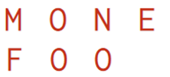
Recurrence
There are exactly three possibilities for the last column in the alignment representation of A[1…i] and B[1…j]
The last character in the bottom row is empty = deletion
Therefore, the edit distance is Edit(i-1, j) + 1
Here, the +1 is the cost for the final deletion
Notes:
19

Slide 11
Recurrence
There are exactly three possibilities for the last column in the alignment representation of A[1…i] and B[1…j]
Last character in both rows is non-empty = replacement OR do nothing
If the characters are different, the edit distance is Edit(i-1, j-1) + 1
If the characters are the same, the edit distance is Edit(i-1, j-1)
Notes:
19

Slide 12
Recurrence
Edit(0,j) is the edit distance between the empty string and a string of length j. This is clearly j
Edit(i,0) is the edit distance between a string of length i and the empty string. This is clearly i
Notes:
19

Slide 13
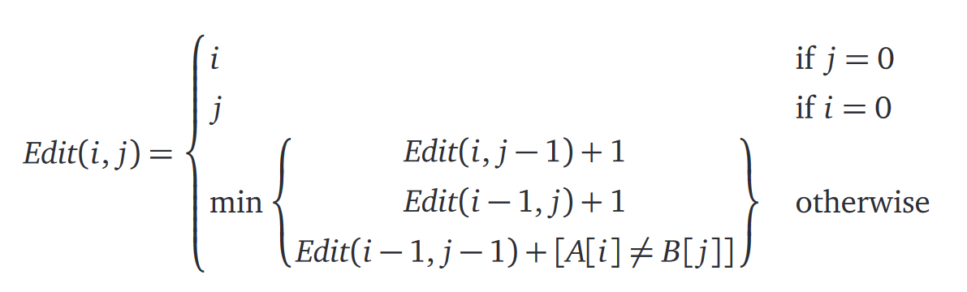
Recurrence
Notes:
19

Slide 14
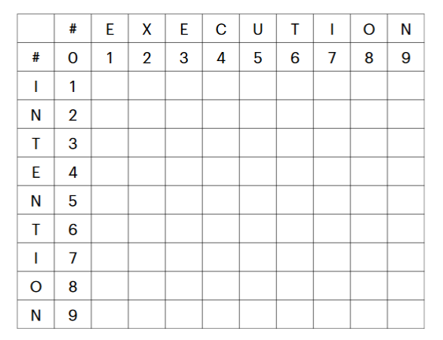
Example
Notes:
19

Slide 15
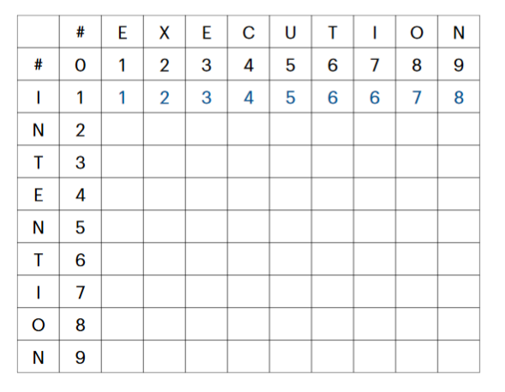
Example
Notes:
19

Slide 16
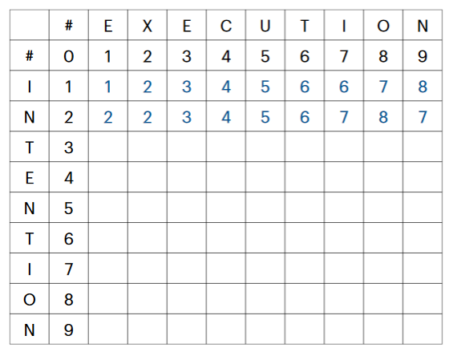
Example
Notes:
19

Slide 17
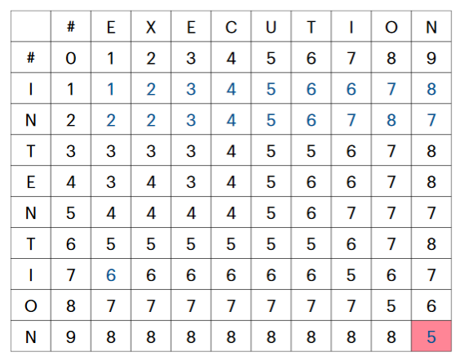
Example
Notes:
19

Slide 18
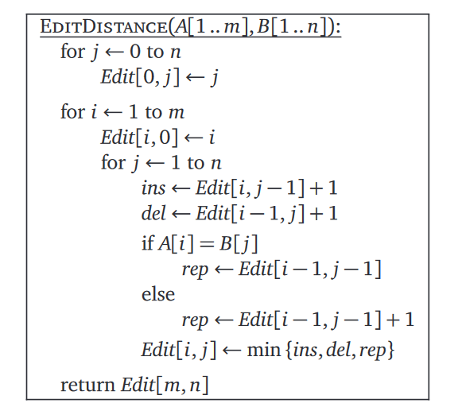
https://jeffe.cs.illinois.edu/teaching/algorithms/book/03-dynprog.pdf
Notes:
<number>

Slide 19
Codebase
Edit Distance skeleton code
TODO: complete method implementations
Remember: separate solving from implementation!
Notes:
<number>

